Slide 1
Human Computer Interaction
ZhenNan Wu(Leader) JiWei Hao
Jinze Yu Zheng Zheng

Slide 2

目录
01 Work Content
02 Work Division
03 Reflection and Expectation

Slide 3
01Work Content
Work Design
Design the interface and divide work in detail.
Demo Design
Design the Binocular function.
Communication
Communicate with each group and follow the schedule.
Logo
Design the logo.
The most important work in Human Computer Interaction Group are design and communication. If there are something urgent happened, we should realize the problem and communicate with groups to guarantee the schedule.

Slide 4

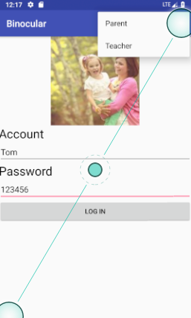




01Work Content
Bincular Function
Health
Location
Dismissal
Message

Slide 5
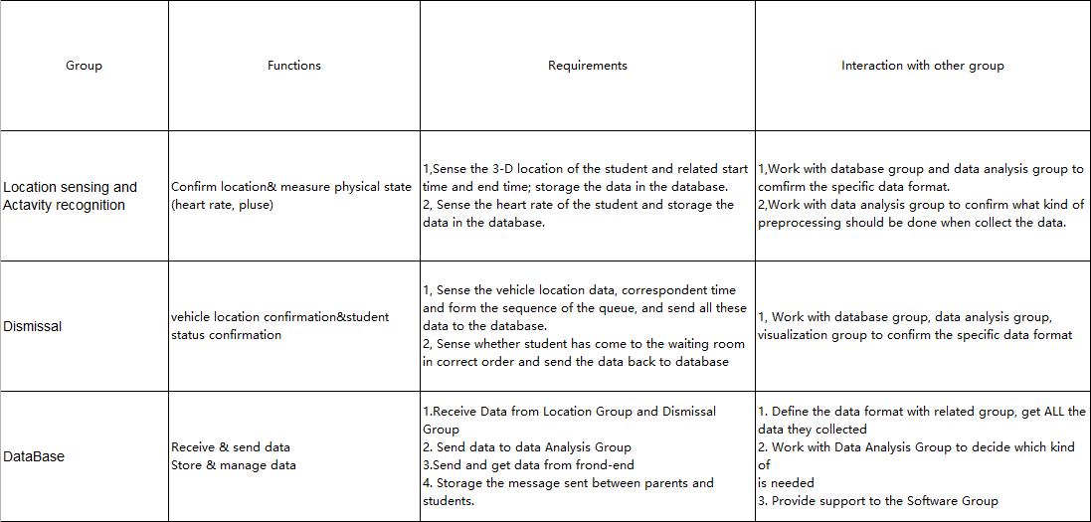
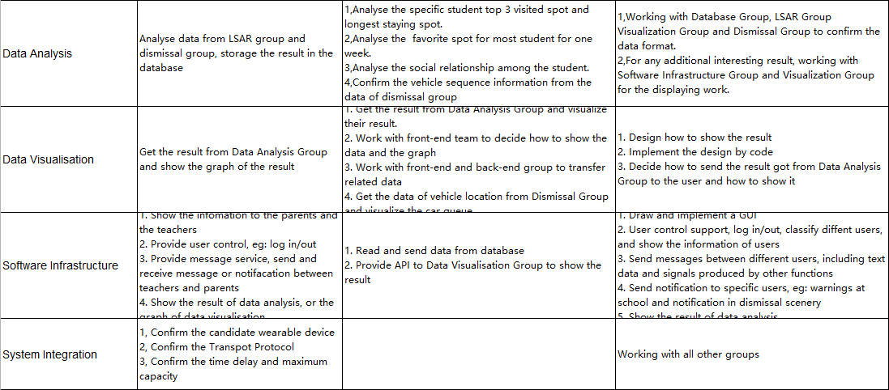
01Work Content

Slide 6
01Work Content
Main Functions
Correspond
- Send teachers information about the child’s condition, the location of the vehicle and the successful receipt of the child
Detection
- Detect child's temperature, heart rate, exercise volume, sleep quality
- Detect student’s interpersonal information
Location
- Get location information of children
- Get location information of parent vehicles

Slide 7
01Work Content
Additional Functions
Correspond
- Send parents the learning status of the child within one week
- Send messages to teachers and parents whether the amount of exercise is up to standard
- Send messages to teachers and parents whether the interpersonal relationship is low
- Send messages when children are in dispute
Detection
- Display the current state of the child's physical condition
- Detect students' concentration in class

Slide 8
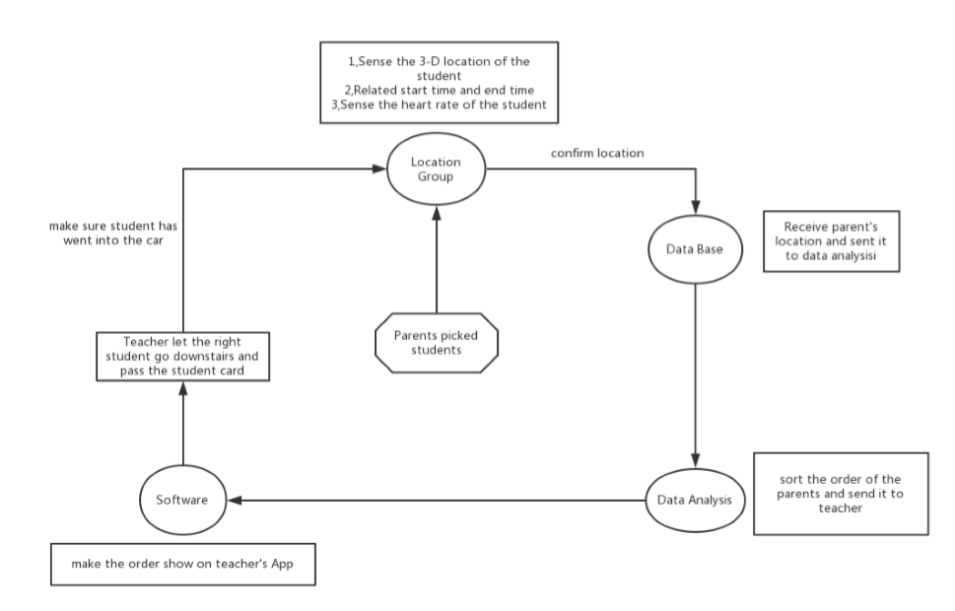
Dismissal Flow Chart

Slide 9
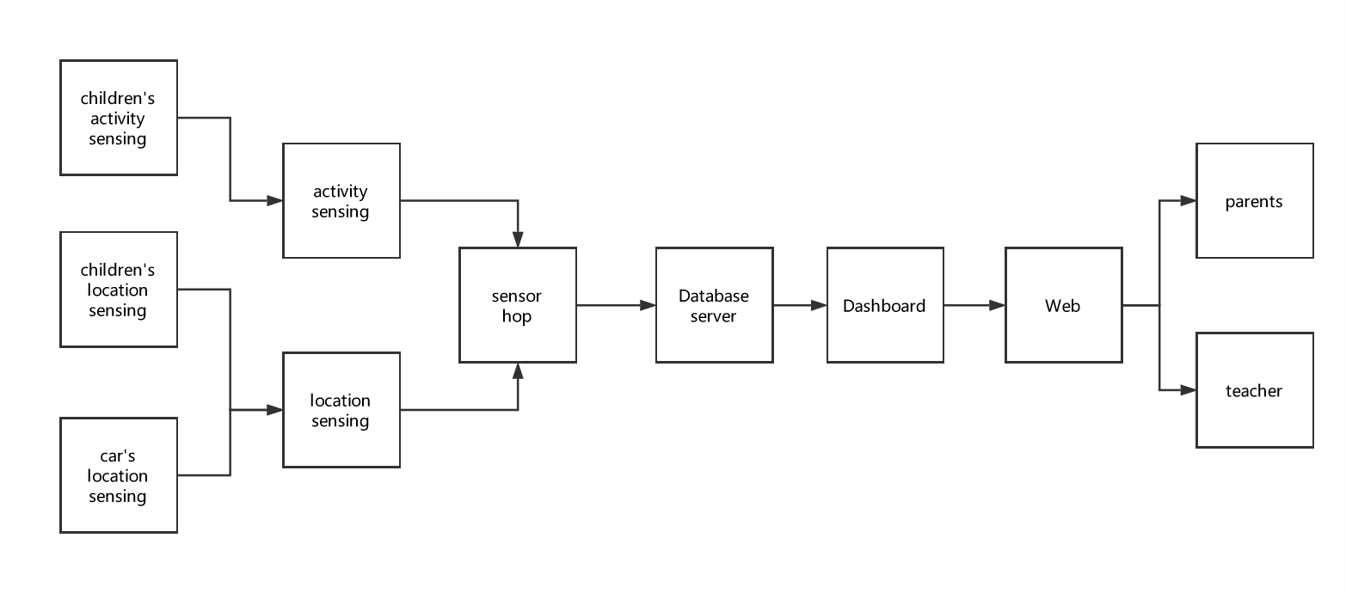
Intergral Flow Chart

Slide 10
02 Work Division
Zhen-Nan Wu(Leader):Developed and presented Visionary scenario, Provide framework to clarify the functional requirements with other groups. Hold the meeting for representatives of all group for the conjunction work. Participated in brainstorming sessions and aided in presentations and reports, suggested team name and logos.
Ji-Wei Hao:participated in brainstorming sessions and put forward the architecture of the system, developed Visionary scenario, summarize all the task all group should accomplish, organize the work of dismissal group and location sensing group, worked on the function & requirement form.
Zheng Zheng: clarify the function requirements with other groups ,make Visonary scenario ppt and presentation ppt ,make picture material, design computer interface ,communicate with Software Group in detail.

Slide 11


03 Reflection and Expectation
Reflection
1, Cooperation is not a easy work. We have to confirm the standard of data format, program languages and API. We also need to know the trouble dependent groups have faced and their adjustment to it to keep our consistency.
2, Find the user demand is challenging, especially plus the match with our capability to resolute our practice. Despite the omit of survey and interview process, the start of the whole project remains challenging.
3, We do learn the whole procedure of rapid prototyping, from the framework to the practice. Since with the march of the project, various problems and difficulties may appear, the clear group setting and task arrangements make great contributions to the problem solving in more structured way.

Slide 12
03 Reflection and Expectation
Expectation
1, With the limit of necessary tools, skills and different work load, groups has different schedule, which may cause contradiction to the dependency order. So if we get tools, we will try to achieve the ultimate goal.
2, Other possible functions: Detect the state of children’s motion tracking, the serve is able to expend to achieve deep learning to analyze data more efficiency.
01
02
04
03

